Slide 1
Config Sizing Process Automation
Jarveis Lam

Slide 2

Problem Statement
Each week, the Sizing process requires manual and tedious effort in collation, report generation and emailing respective recipients.
This repetitive process can be streamlined in order to create a centralized system and that can save time and effort for the team.

Slide 3
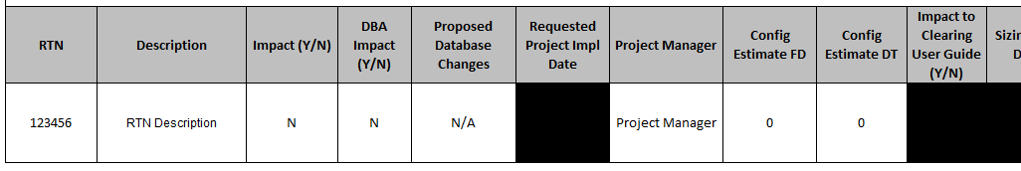
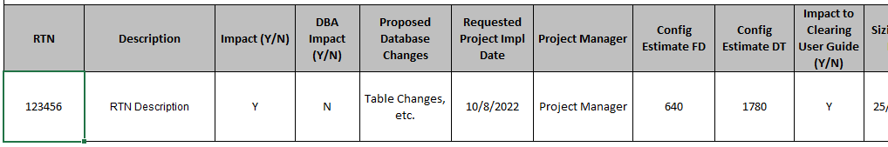
Proposed Solution
Excel, Word, Outlook and VBA.
1
2
Centralized RTN Collation
Users can fill in RTN information according to their types (RTNs with Impacts to Config, No Impacts to Config)
Report and Email Generation
Generate sizing report documents.
Automate creation of email, assigning of recipients, and attaching required sizing report.
Source placeholder

Slide 4
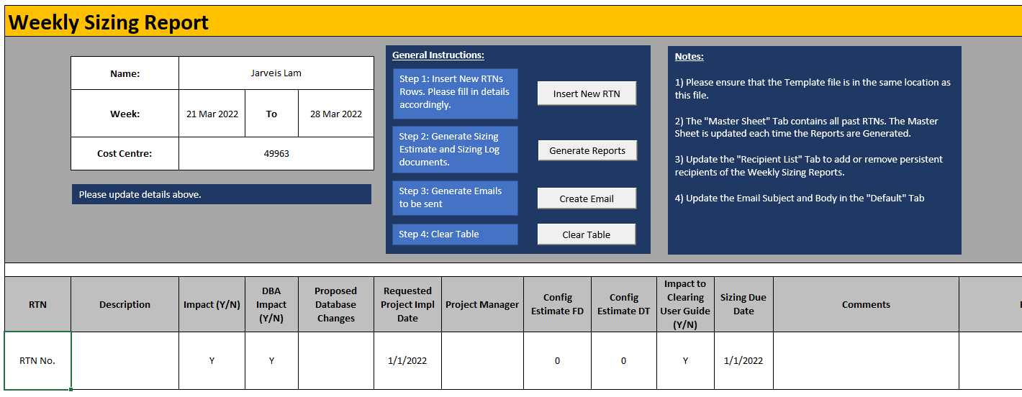
Weekly Sizing Report
How to use
Weekly Sizing Report Excel Sheet
Users can use the buttons to control the document.
Insert New RTN creates a pre-filled row for users
Generate Reports helps collate all RTNs and consolidates their information into 2 Report documents: Estimate & Logging
Create Email opens 2 new emails, attaching the new reports and adding recipients under the Project Manager column
Source placeholder

Slide 5
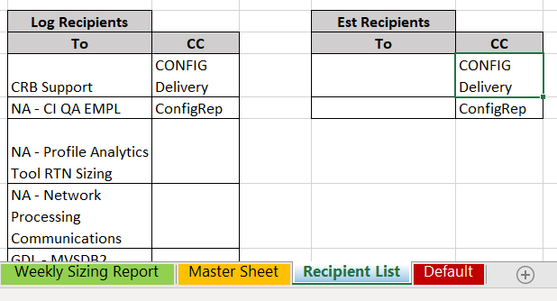
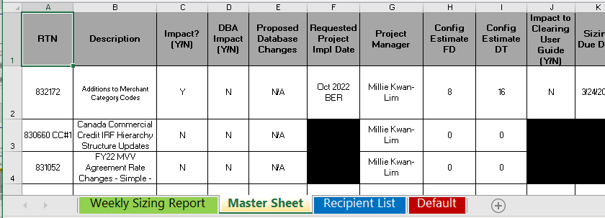
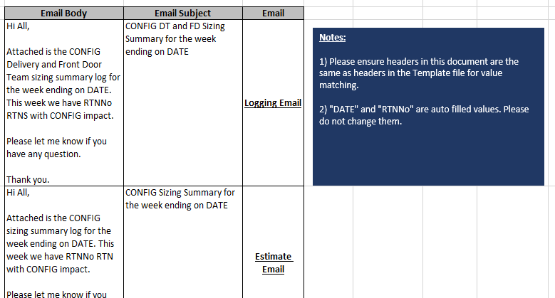
Weekly Sizing Report
How to use
Weekly Sizing Report Excel Sheet
Excel Sheet serves as a centralized documentation of past RTNs and allows for future modifications.
Source placeholder
Notes:
All new and unique RTNs are stored under the “Master Sheet” tab once “Generate Report” is called
Users can modify the standardized “Recipient List” and the E-mail subject and body when necessary
Excel and Template structure of the RTNs can be modified more columns need to be added

Slide 6
Solving the problem
How the Weekly Sizing Report Tool solves the problems stated
Issue 1: Repetitiveness
Sizing report is created each week and sent to a set group of recipients
Helps to reduce repeated actions by automating creation of the emails and assigning standard recipients.
Issue 2: Tedious
2 Different Sizing Reports needs to be updated each week
Creation of the different reports is handled automatically
Collation of the different RTNs can become tedious
Users only update information about an RTN in a central tool
Source placeholder

Slide 9
Impact
Optional subhead placeholder
Headline (Bullet level one)
Body copy (Bullet level two): One column slides have a single column which can be used for text, tables, charts, graphics, or images.
Bullet level three
Bullet level four
Source placeholder

Slide 10
Number list layout
Optional subhead placeholder
Heading (Numbering level One)
Text is Visa Dialect Regular 14pt (Indented level Two)
Text is Visa Dialect Regular 14pt (Indented level Two)
Heading (Numbering level One)
Text is Visa Dialect Regular 14pt (Indented level Two)
Text is Visa Dialect Regular 14pt (Indented level Two)
Heading (Numbering level One)
Text is Visa Dialect Regular 14pt (Indented level Two)
Text is Visa Dialect Regular 14pt (Indented level Two)
Source placeholder

Slide 11
Title, subhead and two column layouts
Optional subhead placeholder
Headline (Bullet level one)
Body copy (Bullet level two): Two column slides have two equal-width columns, each of which can be used for text, tables, charts, graphics, or images.
Bullet level three
Bullet level four
Headline (Bullet level one)
Body copy (Bullet level two): Two column slides have two equal-width columns, each of which can be used for text, tables, charts, graphics, or images.
Bullet level three
Bullet level four
Source placeholder

Slide 12
Title, subhead and three column layouts
Optional subhead placeholder
Headline (Bullet level one)
Body copy (Bullet level two): Three column slides have three equal-width columns, each of which can be used for text, tables, charts, graphics, or images.
Bullet level three
Bullet level four
Headline (Bullet level one)
Body copy (Bullet level two): Three column slides have three equal-width columns, each of which can be used for text, tables, charts, graphics, or images.
Bullet level three
Bullet level four
Headline (Bullet level one)
Body copy (Bullet level two): Three column slides have three equal-width columns, each of which can be used for text, tables, charts, graphics, or images.
Bullet level three
Bullet level four
Source placeholder

